Slide 1
Consumer awareness project
Information provided, Myths debunked, Questions answered

Slide 2
Main points to cover during the session
What are Clinical Trials?
Types of Trials
Common Clinical Trials Terminology
Where to find trial information (including asking about trials at diagnosis, knowing what questions to ask, availability of trials)
Making sure a Clinical Trial is Right for You – including Eligibility & Participation
Trial Safety – Side effects & Oversight
Participation – Cost & Time
Consumer Experience
Regional Participation & Teletrials

Slide 3









What is a Clinical Trial?
How do new:
How do new cutting-edge treatments get to the patients who need them most?
How do we improve known treatments to make them better for patients?
Medications
Cellular Therapies
Surgical Procedures
Radiotherapy Treatments
How do we establish what treatments are more effective than others?
Medical Devices
Preventive Care
Behavioural Treatment
Process of Care Changes
affect patient outcomes?

Slide 4

Types of Trials
Interventional:
Discover the effects of
Observational:
Discover patient outcomes through
Medication
Access medical records
Observing current treatment effects
Surgical Procedures
Medical Devices
Behavioural Treatment
Track health outcomes over time
Track effectiveness of a treatment
in assigned groups of people
without intervening in their treatment

Slide 5



Phases Of trials (focus on cancer)
Evaluate safety
Evaluate safety & efficacy
Establish the correct dose
Compare new treatment to ‘gold standard’
Discover late effects of a treatment
New drugs/combinations
A range of diseases
Focus on a type of disease
Randomised/placebo control trial
Phase I
Phase II
Phase III
Phase IV
IND
Approval
Small number of participants (< 80)
First Time In Human - FTIH
30-100 participants
Large number of participants (>1000)
Intensive, but with limited follow-up
Several months – a year
Several months – 2 years
Several years
Long-term follow up

Slide 6
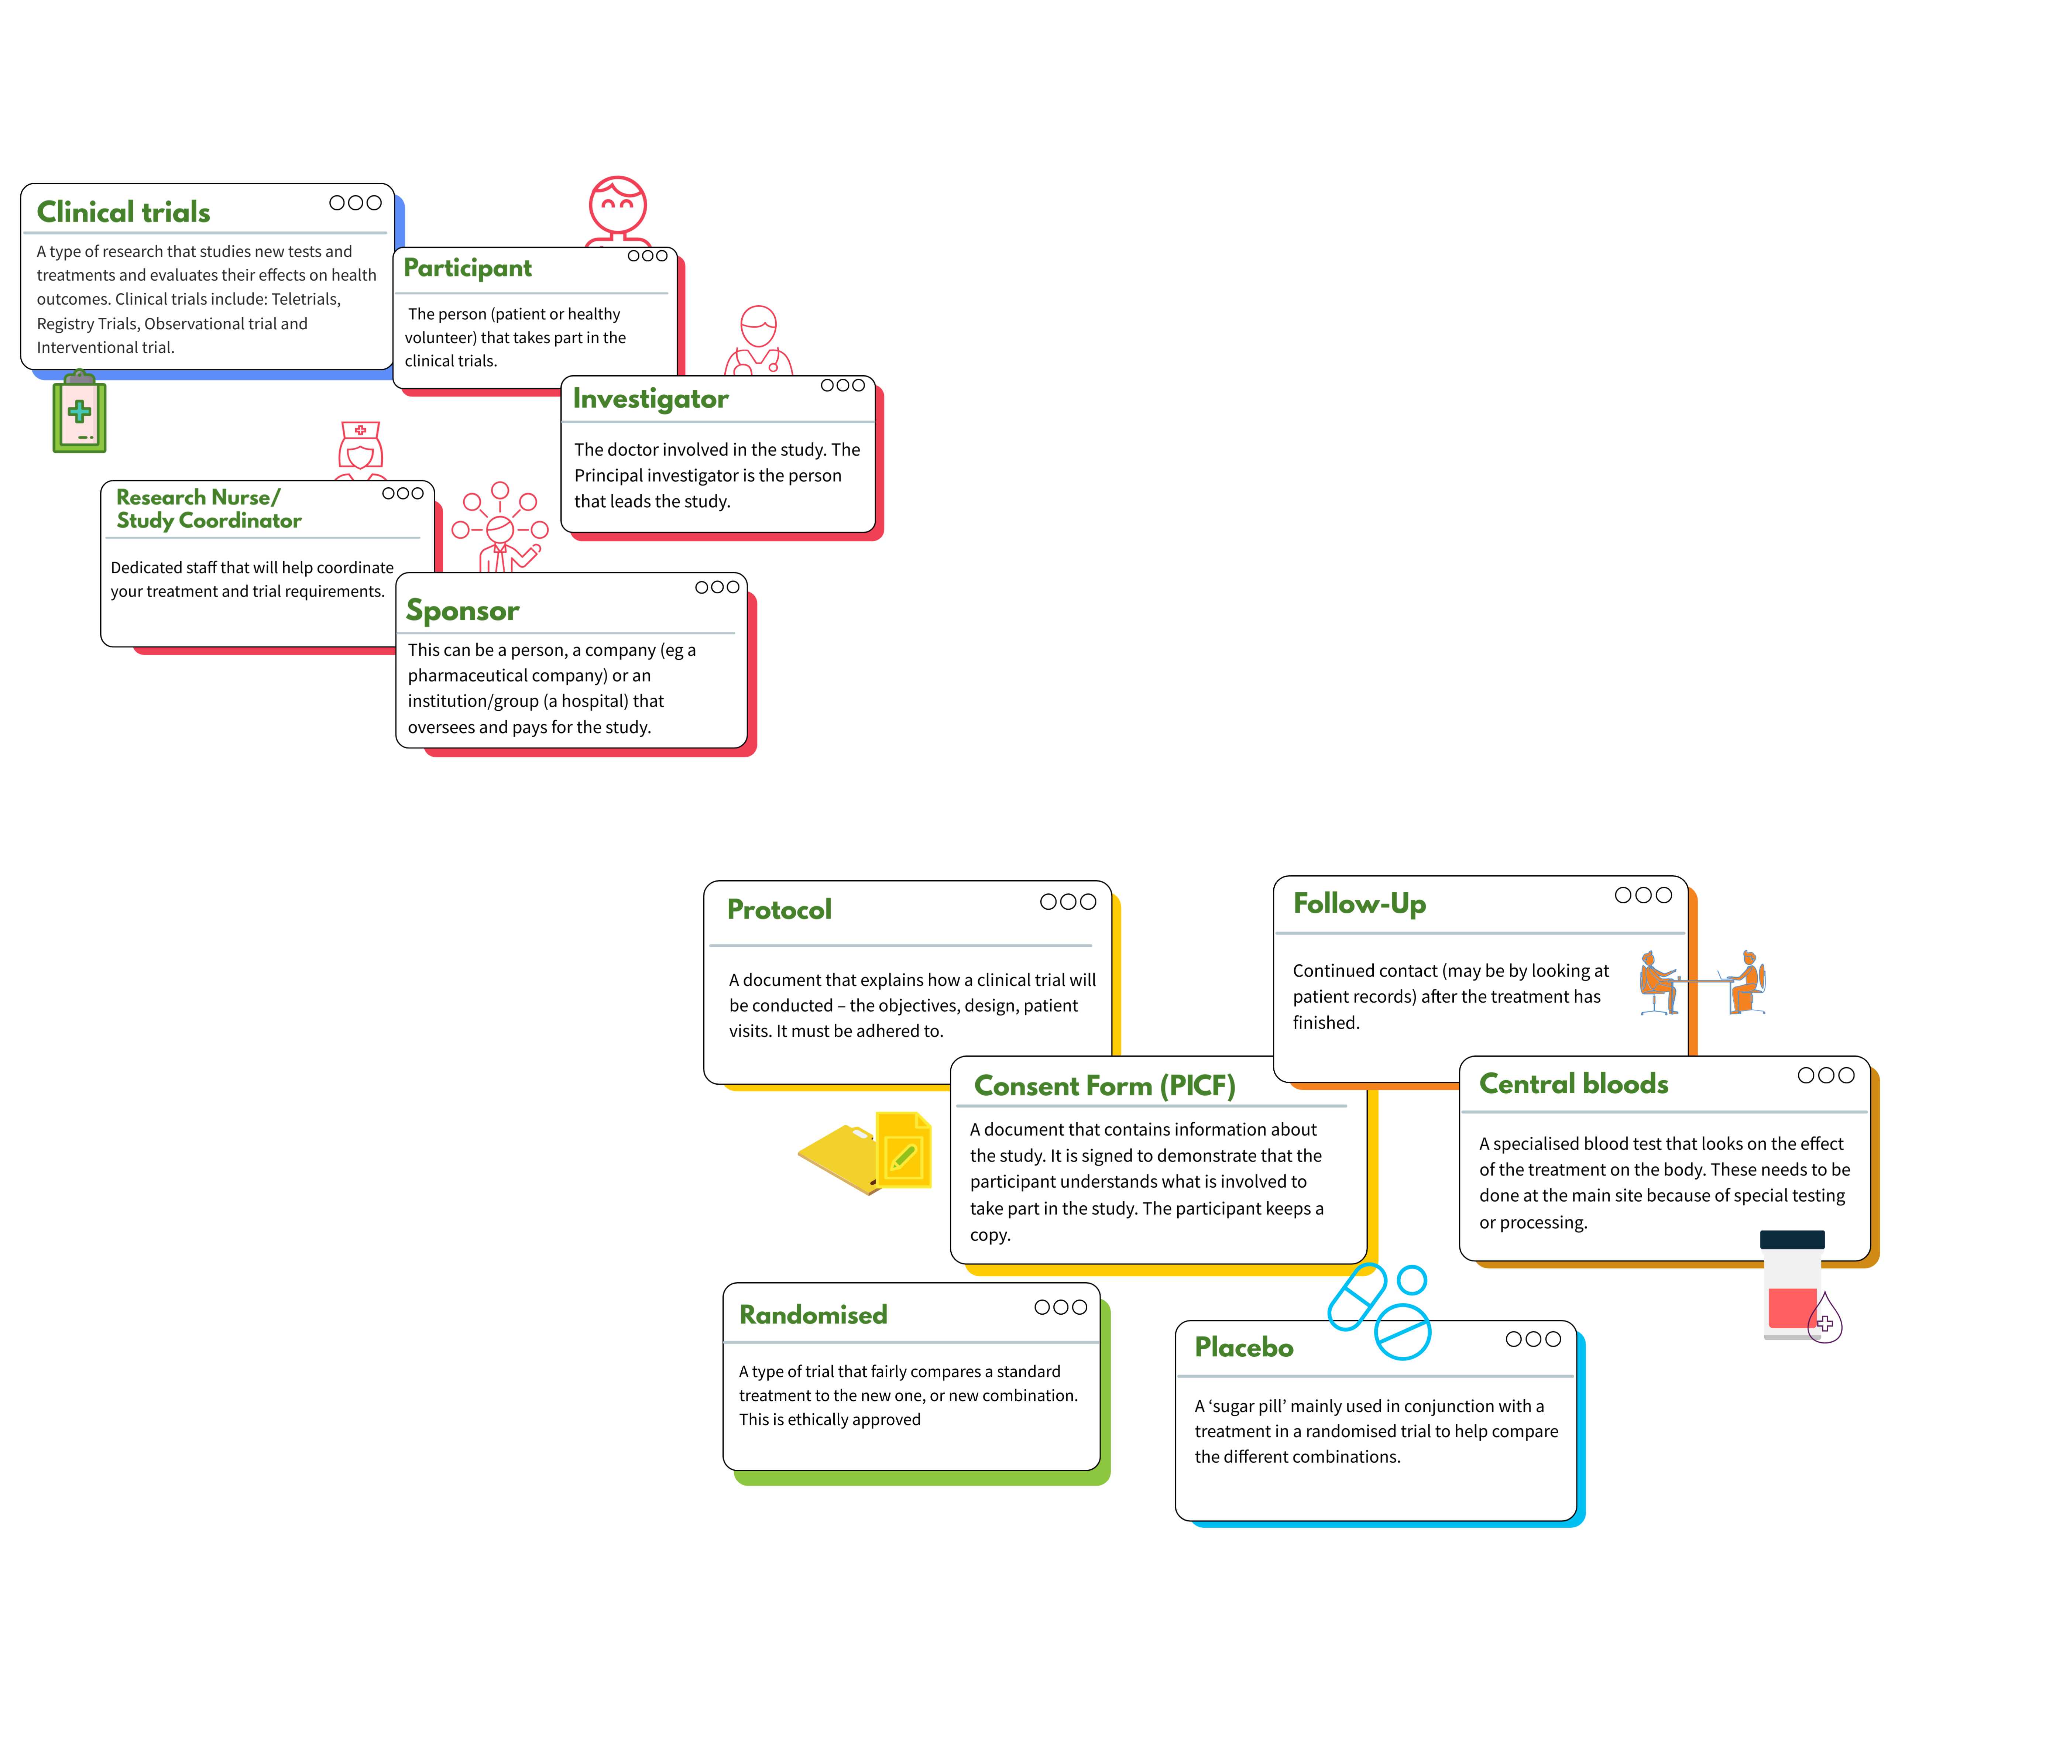
Common Terms Explained
Notes:
Infographic or animation

Slide 7


IS A Clinical trial right for me?
Questions to ask your doctor:
Questions to ask
study nurse/coordinator:
What are the advantages/disadvantages in taking part in this trial?
Are there other clinical trials available to me?
If I do not take part, what are my treatment options?
What happens if I say ‘yes’?
Can I change my mind?
What is eligibility? (next slide)
Are there lots of visits?
Who will see my information on the trial?
Will the trial cost me money? Can I get reimbursements?
There is an “Is a trial right for you?” document available

Slide 8
Consumer Experience
Slide added as placeholder for consumer experience contribution
VCCC Alliance video:
VCCC Alliance Consumer Representative: Melissa Sheldon
VCCC Alliance Consumer Representative: Les Leckie

Slide 9








Focus on eligibility: Who can participate in a trial?
All trials have eligibility criteria. These are to ensure the right types of participants are on the study and to make sure they are safe.
Eligibility is looked at during the screening phase of a trial.
Examples of some inclusion criteria may be:
Having the right type of disease
Having the disease at the right ‘stage’
Health conditions or activity levels
If you blood results are in the right range
If you have received a treatment before
Notes:
Speaker notes:
You can be perfectly well and be asked to join a study (eg. covid vaccines). You can help research
A Phase 3 trial comparing two already approved treatments can have broad eligibility criteria – eg - any fitness level, allowing other health conditions
A Phase 1 trials with a brand new treatment will have a narrower eligibility criteria – eg - The participant should be fit and healthy without underlying conditions that may also be a problem while on trial

Slide 10
A Case Study on Eligibility
Abdul is a 57 man with prostate cancer that recently spread to his bones.
His doctor suggests a clinical trial where half the participants are either randomly allocated to receive a new drug in addition to the standard treatment, or not.
To be eligible they need to find out if:
Abdul’s cancer has a specific ‘genetic marker’. The new treatment only works for patients with that marker.
Abdul’s bloods are within normal range. The new drug can affect certain blood counts so they can’t be too low to start with.
An additional scan also shows the cancer has spread.
Abdul needs to be active and not sleeping for much of the day. Activity is a good measure to see if a patient is fit enough for a trial
Abdul agrees to complete Patient Reported Outcomes (questionnaires) on an electronic device every 6 weeks.
Abdul is happy to come to the hospital for more visits than he would if he was not on trial.
Abdul is happy knowing that there is 50% chance he will not get the new treatment
Notes:
Video available: Animation link: https://www.youtube.com/watch?v=IH6c_NntY5c
Abdul has the chance to discuss the study with the doctor. If and Abdul is happy with the extra commitments and the scans and tests show that he is eligible, then he is able to go on to the study.
Animation link: https://www.youtube.com/watch?v=IH6c_NntY5c

Slide 11
A case study on eligibility: THis trial is not suitable
Mary is a 67 woman with Multiple Myeloma. Her doctor has seen her blood results and has noticed that her disease is progressing after her last treatment.
Her doctor suggests a clinical trial combining a known therapy with a new treatment known as a monoclonal antibody.
To be eligible for the trial the doctor need to confirm:
If her blood results meet the criteria for this study.
  The trial is looking to treat people with a certain level of disease in her blood.
It is also important to know the different treatments Mary has had in the past.
  To be eligible she needs to have been treated with a certain type of medication before.
Mary’s medical history will be reviewed to see if she had any severe allergic reactions to other monoclonal antibody treatments?
  If she has had a reaction to these drugs before, it is not safe to try again.
Finally, Mary is only able to go on trial if she is no longer having severe side effects from her previous treatments.
  If her symptoms are continuing, those will need to resolve before she tries this new treatment.
After reviewing Mary’s medical history, it was noted that Mary had some ongoing side effects that were related to her last treatment. As a result, it was decided that Mary was not eligible for the clinical trial at this time.
She may be eligible in the future, once the symptoms have resolved.

Slide 12



Participation Cost and time
You do not need to pay to be on a trial. Being involved is free and voluntary.
Some trials reimburse for travel, parking, accommodation or time commitment. However, being on some trials may exclude a patient from VPTAS reimbursements.
Treatment, scans, blood tests costs etc are covered by the trial.
In rural areas, trials may cover the cost of scans that are otherwise paid for.
Early Phase trials have many visits which can be burdensome.
Cost
Time
Notes:
It can be cheaper to join a clinical trial as imaging and testing does not cost the patient anything and in rural areas, some providers charge (PET scans)

Slide 13





OVERSIGHT On a clinical trial (e.g., Side effects)
Your safety on a clinical trial is the priority
Your safety is monitored in various ways:
The Study team (doctors and study coordinators) look at blood and test results
Side effects are reported and followed to see bigger trends across more patients
External safety monitoring committees meet throughout the trial to review the data
Any updates about known side effects are passed on to the participant quickly
Depending on the Phase, more may be known about side effects.
The earlier the Phase (e.g. Phase I) the less is known – but participants are closely monitored for any side effects
Before you agree (consent) you should know the risks and how they are monitored.
Notes:
Make sure you are happy to participate

Slide 14



Clinical Trial Requirements and Processes: Informed Consent
  A process by which a subject voluntarily confirms their willingness to participate in a particular trial by signing the PICF (consent form)
  It is advisable to talk to your family, friends and your GP about taking part in a clinical trial
  Informed consent can be withdrawn at any time
Notes:
Speaker Notes:
To be informed means: Have an understanding what the commitment is for the trial, what you are participating in (including tests etc).
Discussion must include the proposed treatment, how many visits are required, possible alternatives, side effects, risks, benefits, whom to call and release of information
To provide consent, participants will partake in a conversation and sign a document called a consent form (Patient Information and Informed Consent Form – PICF)
Ways to provide informed consent: Use of interpreters, Issues of Guardianship, Re-consenting,

Slide 15


Benefits and drawbacks for the patient: Benefits
The participant may get treatment options before the drugs otherwise become available or when there are no other options available (especially phase I or phase II trials)
New treatments may be more effective
Participants are closely monitored and develop a close relationship with research team
Clinical trial care is best practice care as patients are closely monitored

Slide 16



Benefits and drawbacks for the patient: Drawbacks
It is not possible to choose which treatment to have (the new one or the already approved one)
The new treatment might not be more effective or might have more/different side effects than standard treatments
VS
More tests may be needed during and after treatment compared to standard treatments – long days and multiple visits
It may be necessary to fill in more forms and surveys than with standard treatments
Rigid visit schedules can interfere with patient’s lives!

Slide 17
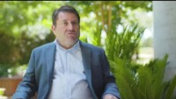


Teletrials
What are they?
Clinical trials that use a Primary and a Satellite model. This means that trials can be more available across rural and regional areas.
Is there one locally?
Ask at your local site or look on the Cancer Council’s Victorian Cancer Trials Link (VCTL)
Why are they better?
Local so less travel/visits for the same treatment
Notes:
https://youtu.be/0LT9Rp26gdo

Slide 18
Where to find information?
Ask your doctor
Patient portals:
Healthmatch
ClinTrialRefer
George Institute
Trial finding websites:
Clinicaltrials.gov
ANZCTR.org.au
Victorian Cancer Trials Link
Clinical Trial professionals’ resources:
vcccalliance.org.au/clinical-trial-innovations
machaustralia.org/resource/vctec
Government resources:
australianclinicaltrials.gov.au
Local Resources:
Notes:
This is a good place to add your local resources.

Slide 19
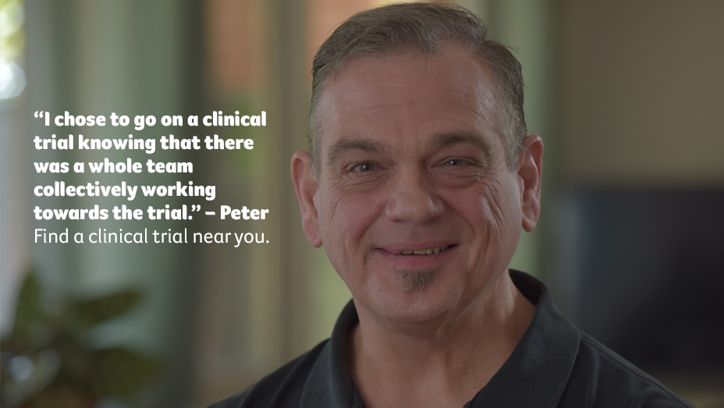
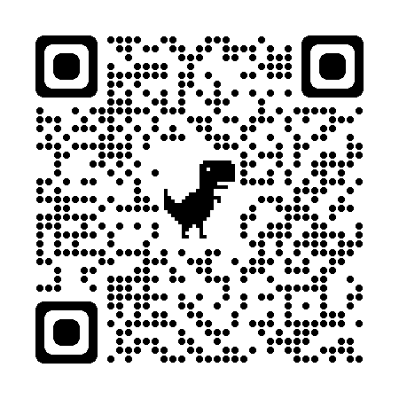
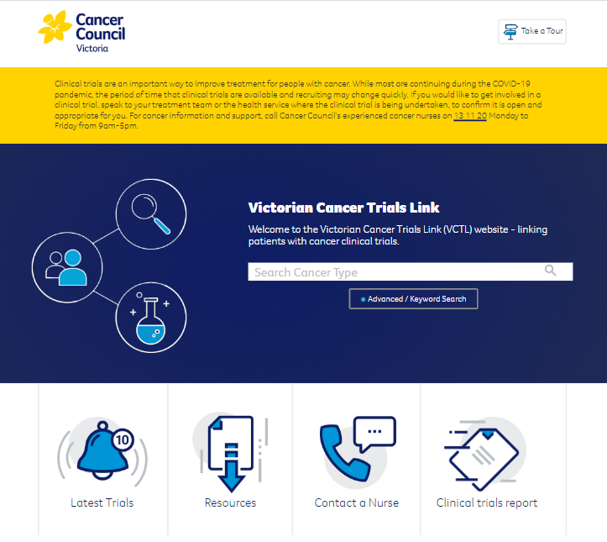
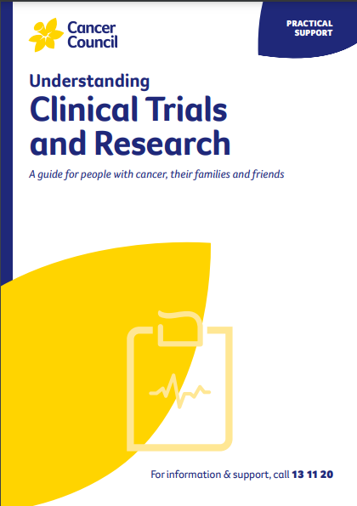
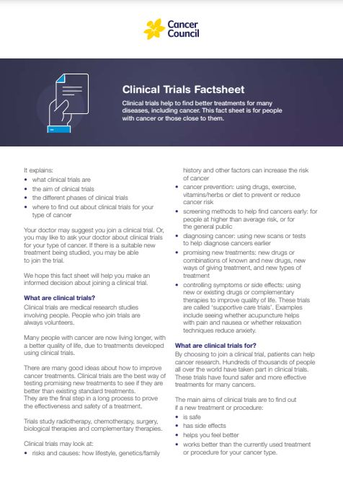
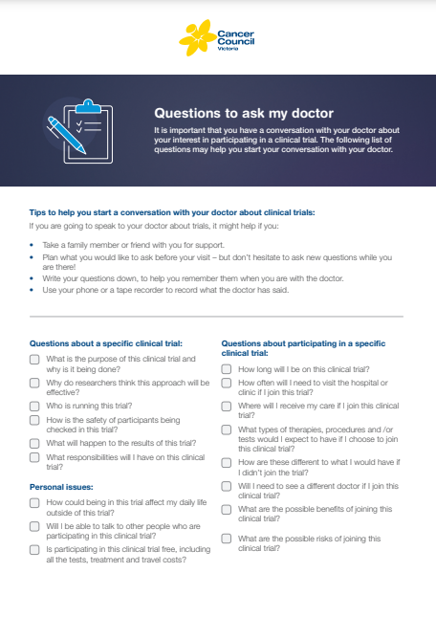
Other resources:
www.cancervic.org.au/trials
Notes:
Cancer Council Victoria has resources to help you understand more about clinical trials and search for cancer clinical trials in Victoria.
This includes the:
Understanding Clinical Trials & Research Booklet, which you can download from the Cancer Council website or order in hard copy here: https://www.cancervic.org.au/resources/
Victorian Cancer Trials Link – a website that you can use to search for clinical trials in Victoria and access general information and support. On this website, you will find an online copy of their booklet, factsheets about clinical trials, a list of questions to ask your doctor, videos of people sharing their experience participating in clinical trials and more.
You can also access support through their 13 11 20 Cancer Information and Support Service (see below).
Cancer Council 13 11 20 Cancer Information & Support
Cancer Council 13 11 20 is a statewide service for all people affected by cancer and all health professionals who support them regardless of where they live in Victoria. It’s free, confidential and staffed by experienced cancer nurses.
You can access this service directly by calling 13 11 20 or by emailing askacancernurse@cancervic.org.au
Phone lines are open Monday-Friday from 9am to 5pm (excluding public holidays).
Cancer Council 13 11 20 nurses can:
explain what cancer is and what will happen during treatment
give you tips for managing common side effects
discuss treatment options, including clinical trials
help you find your way around the health system
provide counselling support
help you care for someone with cancer and look after your wellbeing
provide financial counselling to help you manage the cost of cancer
match you with volunteers with a similar cancer experience to talk to
and much more
If you’re not sure if you want to contact 13 11 20, but would like to know more you can visit the Cancer Council website: https://www.cancervic.org.au/get-support/cancer-support

